Slide 1
Application Layer
Chapter 3
CCNA Exploration 1
Part II

Slide 2
SMTP/POP/IMAP Protocols
Email Services
Simple Mail Transfer Protocol
Post Office Protocol
Internet Message Access Protocol

Slide 3
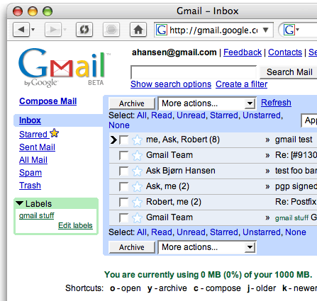
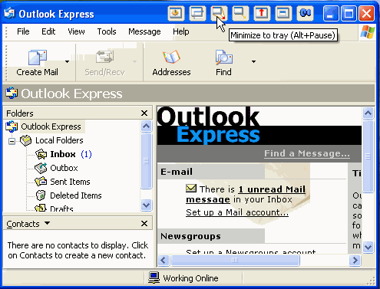
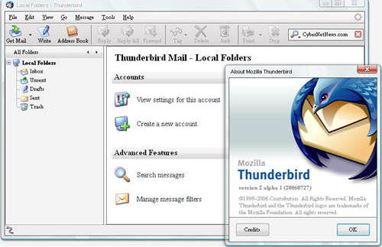
E-Mail Services and SMTP/POP Protocols
Revolutionized how people communicate.

Slide 4

Electronic Mail
Three major components:
Mail User agents
Mail servers
  MDA( is a computer software component that is responsible for the delivery of e-mail messages to a local recipient's mailbox.)
  MTA (The Mail Transfer Agent (MTA) process is used to forward e-mail)
Protocol: SMTP
user
agent
mail
server
user
agent
SMTP
mail
server
user
agent
SMTP
SMTP
mail
server
user
agent
user
agent
outgoing
message queue
user
agent
user mailbox
2: Application Layer

Slide 5
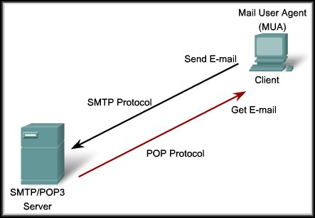
MUA-Mail User Agent
Sends using SMTP
Receives using POP3 or IMAP
Mail User Agent (MUA) also known as an email client.
  Composing, editing, reading mail messages
  E.g., Eudora, Outlook,Mozilla Thunderbird
  Outgoing, incoming messages stored on server

Slide 6
Electronic Mail: mail servers
Mail Servers
mailbox contains incoming messages for user
message queue of outgoing (to be sent) mail messages
SMTP protocol between mail servers to send email messages
  client: sending mail server
  “server”: receiving mail server
  PUSH Protocol
user
agent
mail
server
user
agent
SMTP
mail
server
user
agent
SMTP
SMTP
mail
server
user
agent
user
agent
user
agent
2: Application Layer

Slide 7
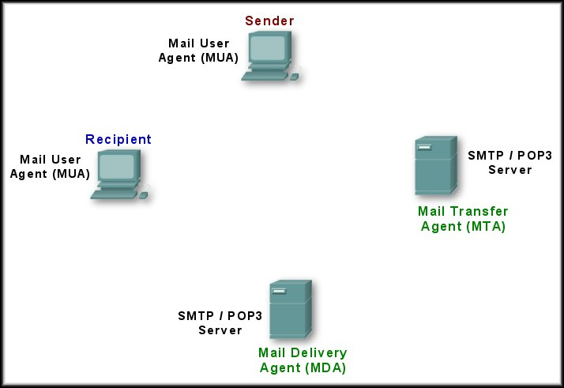
E-Mail Server Processes
Client sends message to MTA using SMTP
Client retrieves message using POP3 or IMAP
Is recipient in my list?
No……Forward to another server.
Yes……Place e-mail in recipient’s mailbox.
Is recipient in my list?

Slide 8


Scenario: Naz sends an email message to Arif
1) Naz uses UA to compose message and “to” arif@someschool.edu
2) Naz’s UA sends message to her mail server; message placed in message queue
3) Client side of SMTP opens TCP connection with Arif’s mail server
4) SMTP client sends Naz’s message over the TCP connection
5) Arif’s mail server places the message in Arif’s mailbox using POP.
6) Arif invokes his user agent to read message
1
3
mail
server
mail
server
5
user
agent
user
agent
2
6
4

Slide 9
Mail access protocols
SMTP
SMTP
access
protocol
user
agent
user
agent
sender’s mail
server
receiver’s mail
server
SMTP: delivery/storage to receiver’s server
Mail access protocol: retrieval from server
  POP: Post Office Protocol [RFC 1939]
    authorization (agent <-->server) and download
  IMAP: Internet Mail Access Protocol [RFC 1730]
    more features (more complex)
    manipulation of stored msgs on server
  HTTP: gmail, Hotmail, Yahoo! Mail, etc.
2: Application Layer

Slide 10
FTP
File Transfer Protocol

Slide 11
FTP: the file transfer protocol
FTP
user
interface
FTP
client
file transfer
FTP
server
user
at host
local file
system
remote file
system
transfer files between a client and a server.
client/server model
ftp: RFC 959
Requires two connections between the client and the server:
  one for commands and replies, TCP port 21
  the other for the actual file transfer,TCP port 20
Notes:
client: side that initiates transfer (either to/from remote)
server: remote host

Slide 12
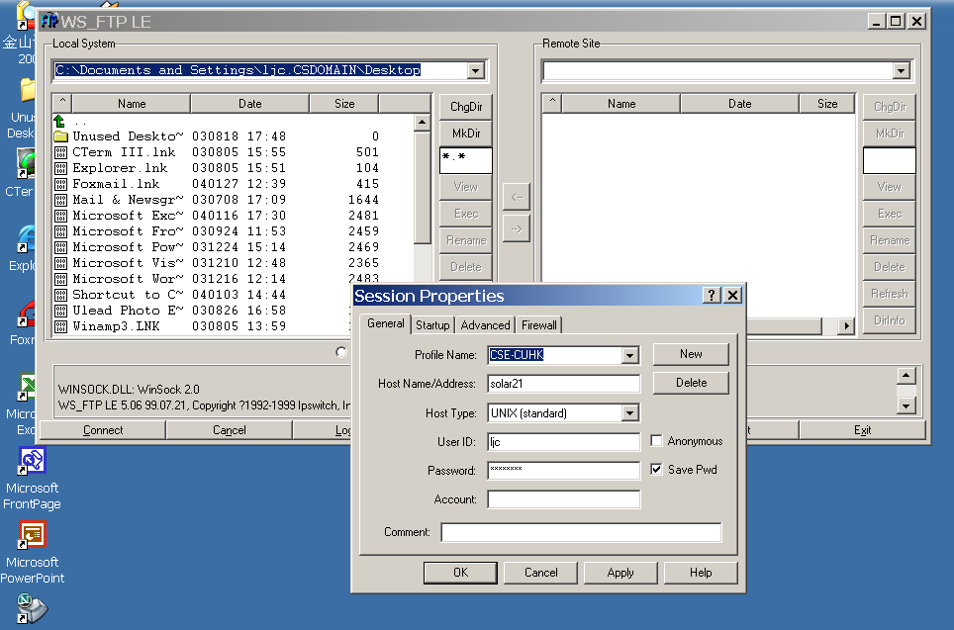
FTP Client Software

Slide 13
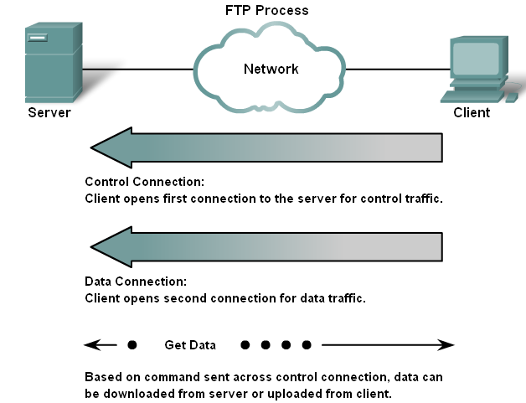
File Transfer Protocol (FTP)

Slide 14
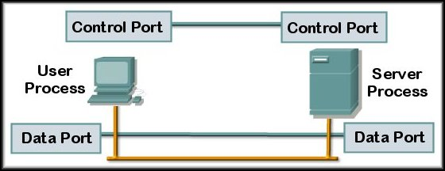

File Transfer Protocol (FTP)
Client initiates a TCP control connection on Port 21. Username and password….
21
20
For each file transferred, TCP opens and closes a Data connection on Port 20.

Slide 15
DHCP
Dynamic Host Configuration Protocol

Slide 16
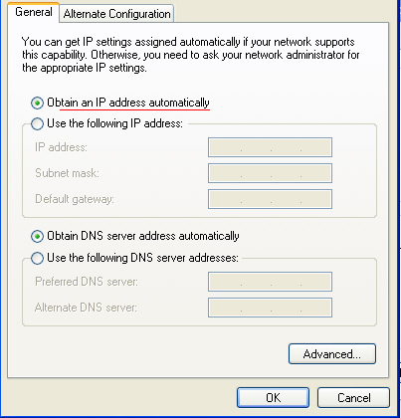
DHCP
Client /Server
DHCP service enables devices on a network automatically to obtain IP addresses and other information from a DHCP server.

Slide 17
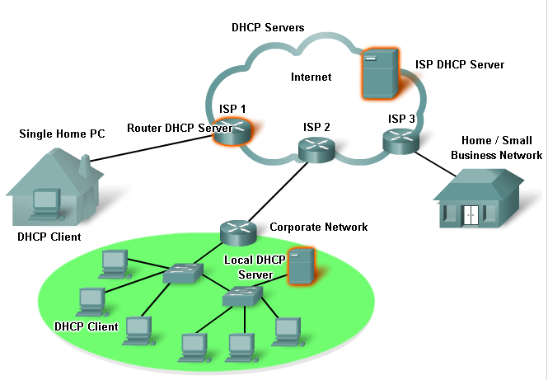
DHCP
DHCP servers can be on a LAN, on a router or at an ISP.
The DHCP server maintains a pool of IP addresses and leases an address to any DHCP-enabled client when the client is powered on.
Notes:
Because the IP addresses are dynamic (leased) rather than static (permanently assigned), addresses no longer in use are automatically returned to the pool for reallocation.

Slide 18
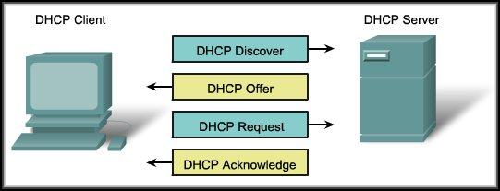
DHCP Operation
DHCP is a four step process.
Client broadcasts a DHCP Discover frame to find a DHCP server. There may be more than one available.

Slide 19
DHCP Operation
A DHCP server responds with a DHCP Offer frame containing a lease time, an IP Address, Subnet Mask, and addresses for a Default Gateway and DNS Server.

Slide 20
DHCP Operation
The client responds by broadcasting a DHCP Request that identifies the server and the lease offer it is accepting.

Slide 21
DHCP Operation
If the offer is still valid, the server returns a DHCP Acknowledgement and records that information as used. If it is no longer valid, a DHCP Negative Acknowledgement is sent and the process begins again.

Slide 22
DHCP Operation
D
O
R
A

Slide 23
DHCP
DHCP can pose a security risk because any device connected to the network can receive an address….
This risk makes physical security an important factor when determining whether to use dynamic or manual addressing.
Dynamic and static addressing both have their places in network designs.

Slide 24


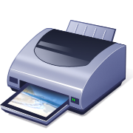

DHCP
Dynamic Addressing:
  Used for general purpose hosts such as end user devices.
Static Addressing:
  Used for network devices such as gateways, switches, servers and printers.

Slide 25
P2P
Peer to Peer

Slide 26
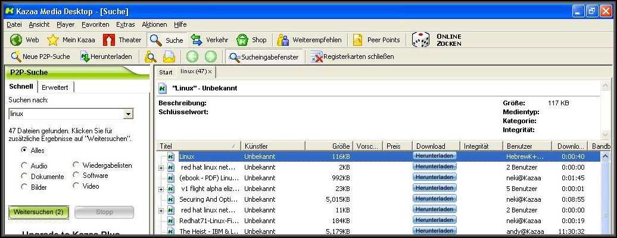
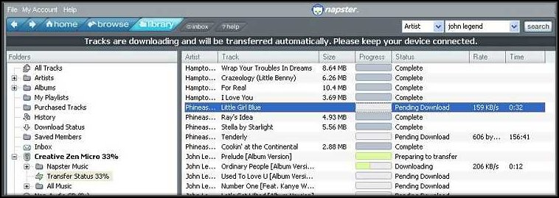
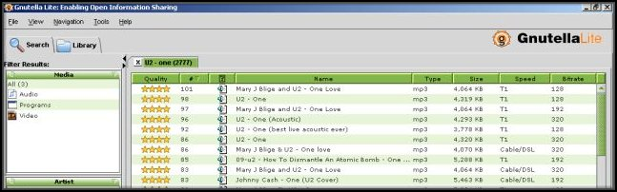
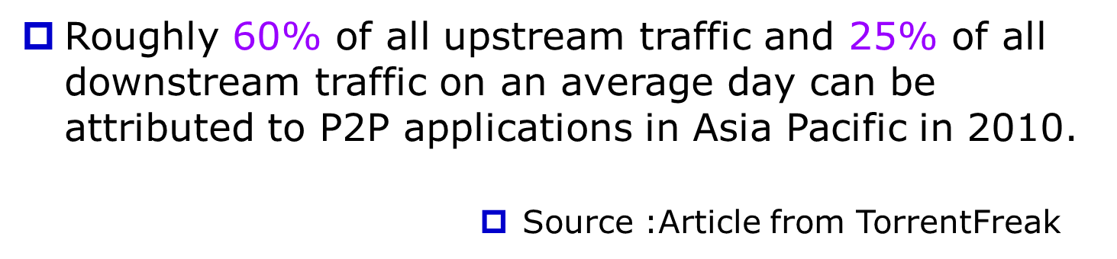
P2P Applications

Slide 27




Pure P2P architecture
No always-on server
Peers (hosts) act as both clients and servers
Most popular P2P protocol now is BitTorrent.
peer-peer
2: Application Layer

Slide 28
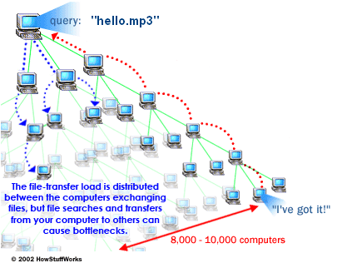
P2P Applications in general
P2P software on your computer sends out a request for the file you want to download.
To locate the file, the software queries other computers.
When the software finds a computer that has the file the download begins.
Others using the P2P software can obtain files they want from your computer's hard drive.
Notes:
P2P software on your computer sends out a request for the file you want to download.
To locate the file, the software queries other computers that are connected to the Internet and running the file-sharing software.
When the software finds a computer that has the file you want on its hard drive, the download begins.
Others using the file-sharing software can obtain files they want from your computer's hard drive.

Slide 29
BitTorrent: Operation
Torrent/Swarm: group of
peers exchanging
chunks of a file
tracker: tracks peers
participating in torrent
obtain list
of peers
trading
chunks
peer
2: Application Layer

Slide 30
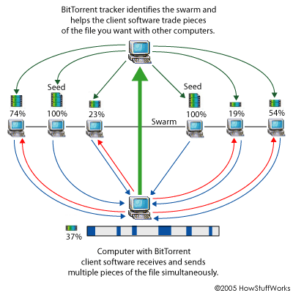
BitTorrent: Operation

Slide 31
BitTorrent: Operation
You open a Web page and click on a link for the file you want.
BitTorrent client software communicates with a tracker to find other computers running BitTorrent that have the complete file (seed computers) and those with a portion of the file (peers that are usually in the process of downloading the file).
The tracker identifies the swarm, which is the connected computers that have all of or a portion of the file and are in the process of sending or receiving it.
The tracker helps the client software trade pieces of the file you want with other computers in the swarm. Your computer receives multiple pieces of the file simultaneously.

Slide 32
BitTorrent: Operation
If you continue to run the BitTorrent client software after your download is complete.
Others can receive .torrent files from your computer.
Your future download rates improve because you are ranked higher in the "tit-for-tat" system.
Leeches
Seeder
.torrent
Swarm
Tracker

Slide 33
Telnet

Slide 34
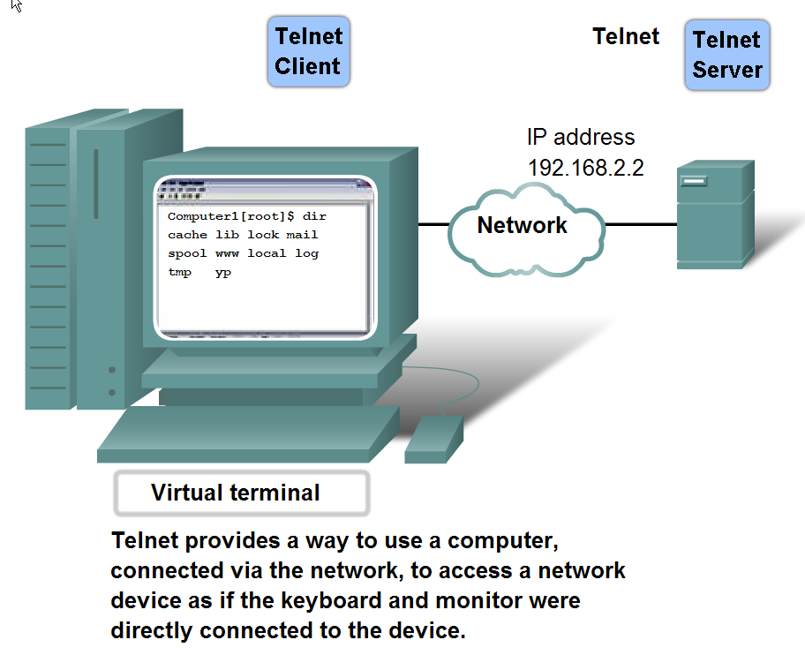
Telnet Services and Protocols
Once networks were available, people needed a way to remotely access the computer systems.
Notes:
Once networks were available, people needed a way to remotely access the computer systems. in the same manner that they did with the directly attached terminals.
Telnet met that need

Slide 35
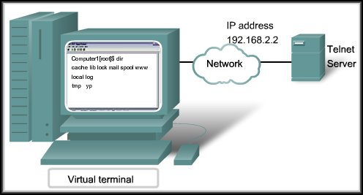
Telnet Services and Protocol
Allows a user to remotely access another device (host, router, switch).
A connection using Telnet is called a Virtual Terminal (VTY) session or connection.

Slide 36
Telnet Services and Protocol
Telnet uses software to create a virtual device that offers the same features as a terminal session command line interface (CLI).
Telnet Clients: Putty, Teraterm, HyperTerminal

Slide 37
Telnet Services and Protocol
Telnet supports user authentication but does not encrypt data (clear text).
Secure Shell (SSH) protocol offers a secure method for server access.
  Stronger authentication, encrypts data

Slide 38
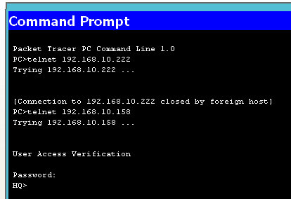
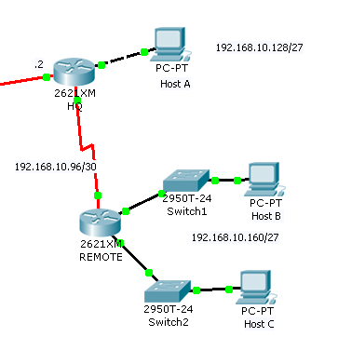
Telnet Example

Slide 39
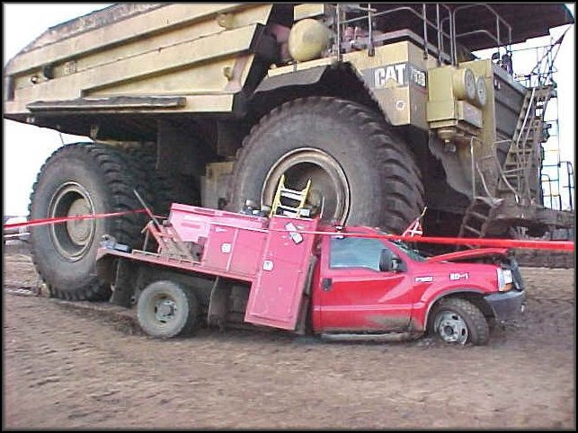
Does it feel like this????

